Slide 1
Introduction to Functional and Anatomical Brain MRI Research
Dr. Henk Cremers
Dr. Sarah Keedy

Slide 2
Last week: MRI physics - Summary
MRI:
Protons align in strong magnetic field
Applying another magnetic field tips the protons in orthogonal direction
Protons start to return to their initial position = measurable signal
With clever pulse sequences we can measure the signal “step-by-step” from different locations in the brain, and reconstruct the signal into an image
F(MRI)
Because deoxy and oxyhemoglobin have different magnetic properties we can measure oxygen consumption (~brain activity)

Slide 3
Course Overview
Week 1: Introduction
Week 2: Processing of FMRI data *
Week 3: Statistical Analysis of fMRI data
Week 4: Planning MRI Research to address your scientific question
Week 5: Interpretation, limitations and new applications of fMRI
* some Illustrations from Martin Lindquist’ Coursera Course & wagerlab

Slide 4
Data Acquisition
Experimental Design Scanning Parameters Reconstruction
Preprocessing
Quality Assurance/Control
Slice-time Correction
Co-registration
Smoothing
Motion Correction
Normalization
(Tissue Classification)
Statistical Analysis
General Linear Model
Subject-level – Parameter estimation
Group Level – Hypothesis testing
Advanced Analysis
Connectivity (Network approaches)
Machine Learning

Slide 5
….Before preprocessing
Quality Control 1: Check the images for distortions
Susceptibility artifacts (due to magnetic field inhomogeneity)
Signal drop out in the OFC

Slide 6
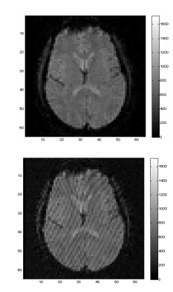
….Before preprocessing
Quality Control 1: Check the images for distortions
Susceptibility artifacts (due to magnetic field inhomogeneity)
Signal drop out in the OFC
K-space artifacts (image reconstruction)
“stripes” in the images.

Slide 7
….Before preprocessing
Quality Control 1: Check the images for distortions
Susceptibility artifacts (due to magnetic field inhomogeneity)
Signal drop out in the OFC
K-space artifacts; “stripes” in the images.
Spikes (gradient artifacts)

Slide 8
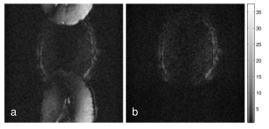
….Before preprocessing
Quality Control 1: Check the images for distortions
Susceptibility artifacts (due to magnetic field inhomogeneity)
Signal drop out in the OFC
K-space artifacts; “stripes” in the images.
Spikes (gradient artifacts)
Ghosting; wrap around in images

Slide 9
….Before preprocessing
Quality Control 1: Check the images for distortions
Although it is important to always look at the images before you start analyzing:
Artifacts are not always easy to detect by visual inspection
It is not always clear what to do when you have found an artifact
There are some toolboxes that help detect artifacts and set criteria for correction of exclusion of data (NYU toolbox, ART; artifact repair)

Slide 10
Slice-time Correction * Motion Correction * Image Registration * Classification * Normalization * Smoothing
Slice-time correction:
Correcting for differences in the acquisition time of the BOLD signal of different slices.

Slide 11
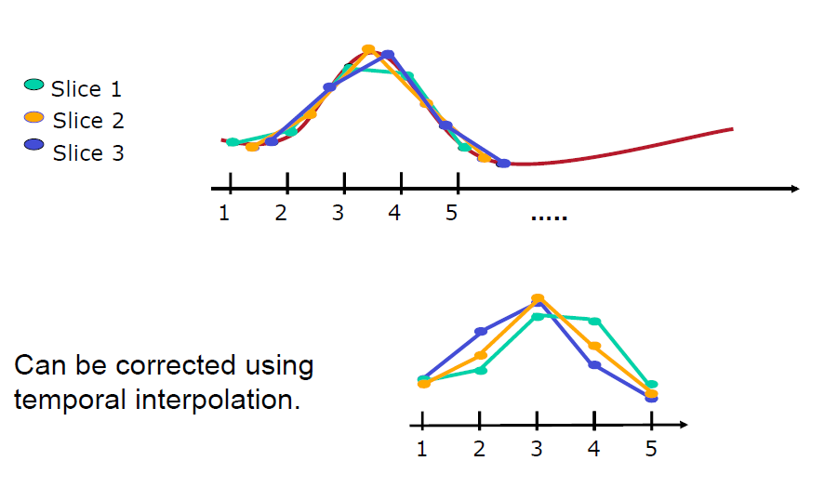
Slice-time Correction * Motion Correction * Image Registration * Classification * Normalization * Smoothing
Slice-time correction:
Correcting for differences in the acquisition time of the BOLD signal for different slices.

Slide 12
Slice-time Correction * Motion Correction * Image Registration * Classification * Normalization * Smoothing
Slice-time correction:
Correcting for difference in the acquisition time of the BOLD signal for different slices.
Important for event-related designs (not block designs)
Only apply if you are very sure about the acquisition order of the slices (ascending/descending/interleaved)

Slide 13
Slice-time Correction * Motion Correction * Image Registration * Classification * Normalization * Smoothing
Head movements during an experiment can (severely) disrupt the signal you measure
(As always) better prevent than correct -- good instructions to subjects & eg. use pads to minimize head movement
There are 2 main ways to correct for the head motion
Preprocessing: Realignment (overlay different volumes properly)
Statistical model: Inclusion of motion parameters in the model (week 3)

Slide 14
Slice-time Correction * Motion Correction * Image Registration * Classification * Normalization * Smoothing
Realignment

Slide 15
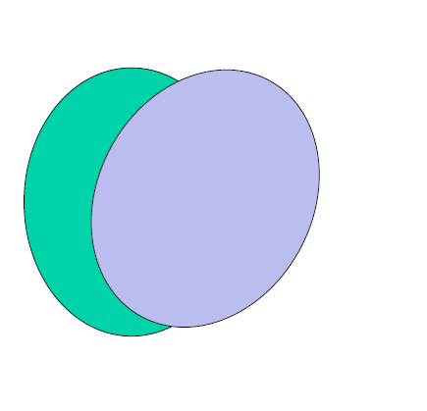
Slice-time Correction * Motion Correction * Image Registration * Classification * Normalization * Smoothing
Realignment

Slide 16
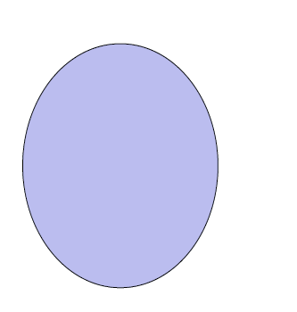
Slice-time Correction * Motion Correction * Image Registration * Classification * Normalization * Smoothing
Realignment

Slide 17
Slice-time Correction * Motion Correction * Image Registration * Classification * Normalization * Smoothing
Linear Transformations:
Rigid body – translation and rotation
Similarity – translation, rotation and a single global scaling
Affine – translation, rotation, scaling, shearing

Slide 18
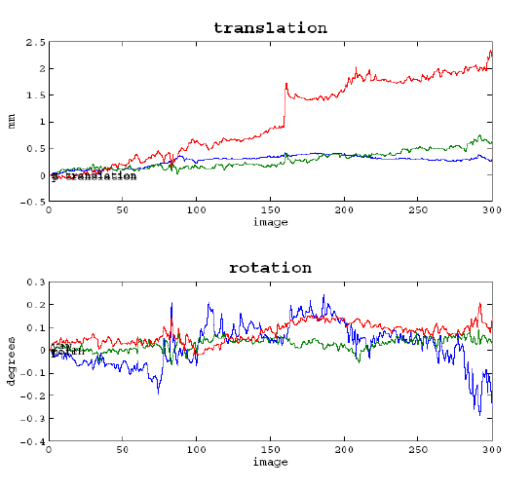
Slice-time Correction * Motion Correction * Image Registration * Classification * Normalization * Smoothing
Quality Control 2: Check the motion parameters.
max 3 mm (voxel size) translation in any direction
Look for large sudden chances
The (spm) program ART can “automatically” check this.

Slide 19
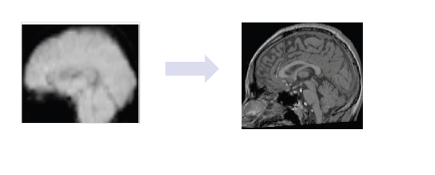
Slice-time Correction * Motion Correction * Image Registration * Classification * Normalization * Smoothing
Co-registration is the process of aligning different type of images (eg. structural and functional)
This helps later transformation to a standard coordinate system (normalization)
This is a more complicated process that realignment because the images (1) do not have the same signal intensity in the same areas (2) differ in shape.
This involves optimizing a cost function, usually mutual information
It may be necessary to first “skull-strip” the structural image (eg. FSL ‘s BET)

Slide 20
Slice-time Correction * Motion Correction * Image Registration * Classification * Normalization * Smoothing
Co-registration is the process of aligning different type of images (eg. structural and functional)
Quality Control 3: Check if the functional and structural images overlap (eg. use spm Check Reg or FSL view)

Slide 21
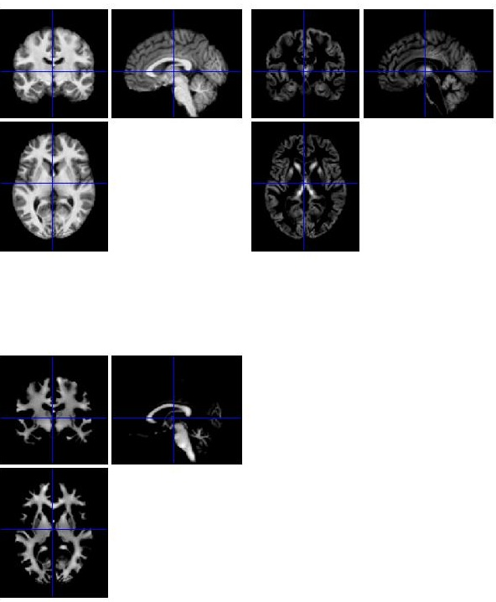
Slice-time Correction * Motion Correction * Image Registration * Classification * Normalization * Smoothing
Tissue classification: determining from a structural image, white matter, grey matter and CSF
If the classification is accurate, this process will also produce accurate normalization parameters.
Grey matter maps are especially of interest, because they can be used for Voxel Based Morphometrty (VBM) analysis.

Slide 22
Slice-time Correction * Motion Correction * Image Registration * Classification * Normalization * Smoothing
Normalization:
Brains are substantially different in size and shape; in order to compare different brains of different people they have to be warped (stretch, squeeze) to the same standard space.

Slide 23
Slice-time Correction * Motion Correction * Image Registration * Classification * Normalization * Smoothing
Normalization:
Brains are substantially different in size and shape; in order to compare different brains they have to be warped (stretch, squeeze) to the same standard space. This process is similar to co-registration.
Another advantage is that you can use standard stereotaxic space (Talaraich; MNI).
… The algorithm behind normalization can get “stuck” into a local minima; can be avoided by aligning the images manually beforehand (setting the origin)
Quality Control 4: Check if the normalized images overlap with a template image (eg. use SPM check reg or FSL view)

Slide 24
Slice-time Correction * Motion Correction * Image Registration * Classification * Normalization * Filtering
Filtering: (1) Spatial Smoothing:
Blurring of an image; to increase signal-to-noise, validate distribution assumptions (random field theory) and remove artifacts.
The amount of smoothing is expressed in the Full-Width-Half-Maximum (FWHM) of the smoothing kernel (usually around 4-10 mm)
…decreases the resolution (and anatomical specificity)

Slide 25
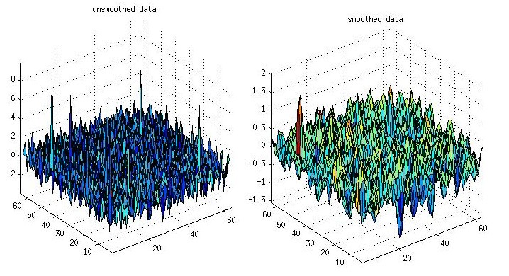
Slice-time Correction * Motion Correction * Image Registration * Classification * Normalization * Filtering
Filtering: (1) Spatial Smoothing:

Slide 26
Slice-time Correction * Motion Correction * Image Registration * Classification * Normalization * Filtering
Filtering (2)Temporal Domain
Remove noise frequencies from the time-series data
High pass filter (remove low frequency drifts)
Low pass (to remove higher frequency “noise” –eg. respiration, heart rate)
In SPM, the temporal filtering is actually done at the statistical model level (topic of week 3)
Quality control 5: Always be aware of the frequency of your task, you don't want to filter that out the signal you are interested in (can be checked with SPM check design).
Make sure you present stimuli often enough, eg. don’t present one type of stimuli just once or twice in a scanning session (topic of week 4).

Slide 27
Slice-time Correction * Motion Correction * Image Registration * Classification * Normalization * Smoothing
Preprocessing:
Always go for default options, unless there is a specific reason to change them
Check the output carefully.
Sample SPM preprocessing steps:
Realign: estimate & reslice (functional images)
Co-register
Reference: Mean image of realignment
Source: Structural
Segment (defaults)
Normalize: realigned functional images to MNI (use parameters from segmentation)
Smooth. FWHM = 6 6 6
QC shortcut: check if the normalized functional images roughly overlap with a template (eg. MNI) brain.

