Slide 1
Introduction to RCC for
Intro to MRI 2014
July 25, 2014

Slide 2
Contact Info
Website: rcc.uchicago.edu
User Guide: docs.rcc.uchicago.edu
E-mail: help@rcc.uchicago.edu
Walk-in: Regenstein 216

Slide 3
Midway Compute Cluster
Shared High-Performance Computing resource for all researchers at UChicago
Comprised of:
  ~10,000 CPU cores
  ~1.5PB of storage
  Nvidia GPU Devices
  Intel Xeon Phi Devices
  Large memory nodes

Slide 4
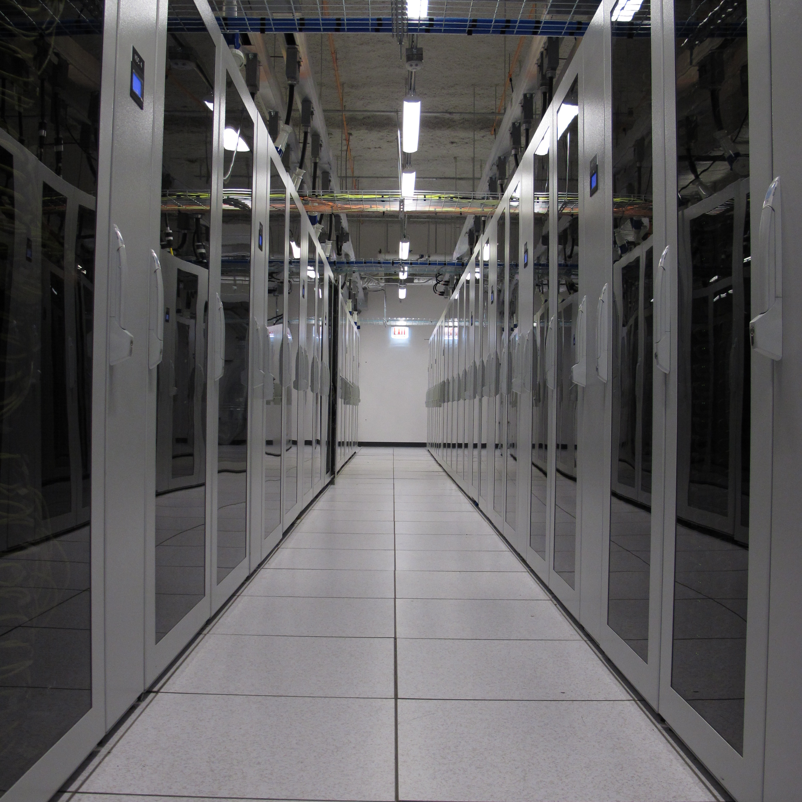

Slide 5
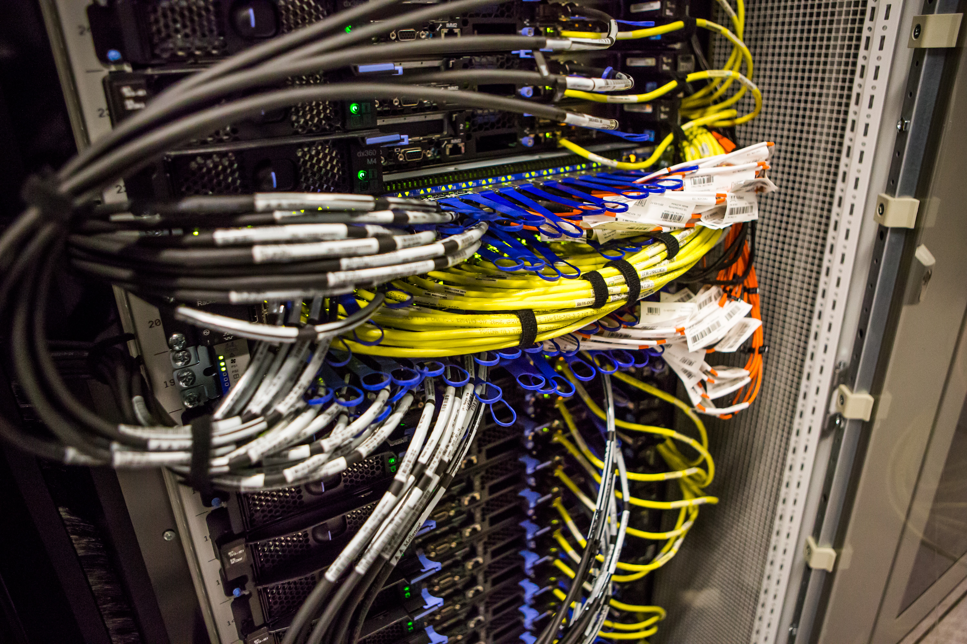
Midway Compute Cluster

Slide 6
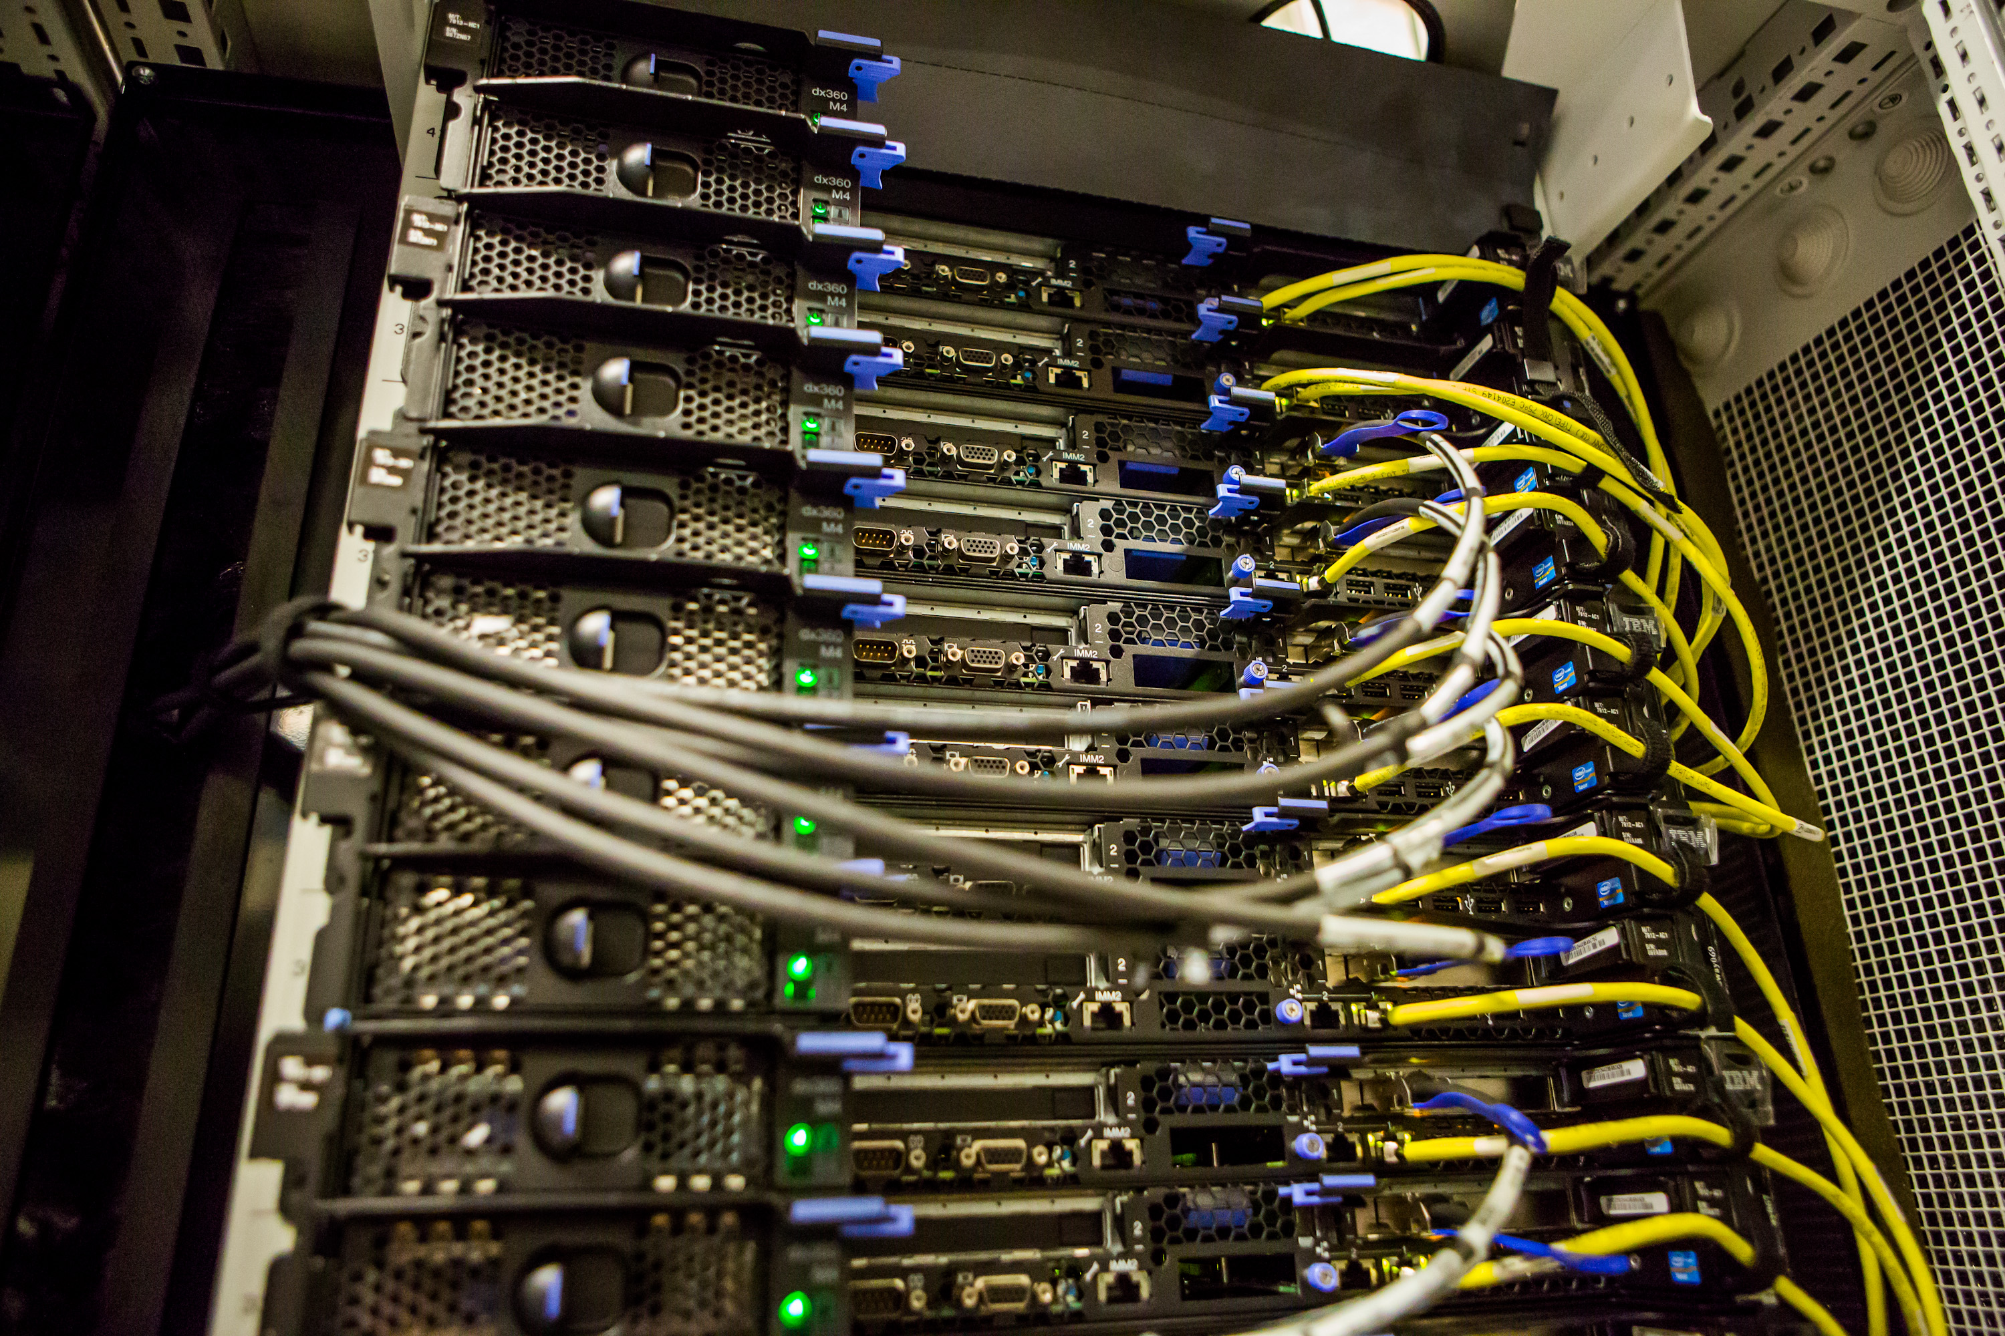
Midway Compute Cluster

Slide 7
Credentials
All credentials are pulled from UChicago ITS
  Uername: CNetID
  Password: CNet Password

Slide 8
Logging In
SSH:
  Remote Command Line Interface tool
NoMachine (NX)
  Remote Graphical User Interface tool

Slide 9
Logging In with SSH
Hostname: midway.rcc.uchicago.edu
Username: CNetID
Password: CNet Password
Windows users:
  Use PuTTY
Mac users:
  Use Terminal app
  ssh cnetid@midway.rcc.uchicago.edu

Slide 11
Home and Project
Home Directory:
  /home/cnetid
  Private space for your files
  25GB quota
Project Directory:
  /project/intromri2014
  Shared space for files shared by your group
  500GB quota

Slide 12
Moving around the Filesystem
Some shorthand:
  Current directory is represented by:
  .
  Parent directory is represented by:
  ..
  Home is represented by:
  ~

Slide 13
The Filesystem
/
  /home
    /home/dylanphall
    /home/robinweiss
  /project
    /project/rcc
      /project/rcc/workshops
        /project/rcc/workshops/linux
    /project/pi-smith
    /project/intromri2014
  /scratch
  /usr
  /etc
  …

Slide 14
Moving around the Filesystem
pwd
  Display the present working directory
cd ..
  Change “up” one directory
cd /home/cnet
  Change to a directory with an absolute path
cd cnet/
  Change to a directory with a relative path
cd ~
  Go home

Slide 15
Looking around with ls
ls
  List directory contents
ls -l
  List directory contents with details
ls -lt
  List directory contents by time of file modification
ls -ltr
  Same as -lt but reverses order
ls -lh
  List directory contents with “human readable” file sizes

Slide 16
More Commands
mkdir /path/to/dir
  Makes a new directory
cp /path/to/file1 /path/to/file2
  Copy a file from loc1 to loc2
cp –r /path/to/dir1 /path/to/dir2
  Copy a directory from loc1 to loc2

Slide 17
More Commands
mv /path/to/file1 /path/to/file2
  Move a file or directory from loc1 to loc2
rm /path/to/file1
  Remove or delete file1
rm –r /path/to/dir1/ <<DANGER>>
  Remove or delete dir1

Slide 18
Moving files to/from Midway
SCP command line
SFTP Client
  WinSCP
  FileZilla
  Transmit
SAMBA

Slide 19
Interactive Jobs
sinteractive
  Default: 1CPU, 2GB memory, 2 hours
sinteractive --time=HH:MM:SS
  Use this to get more time

Slide 20
Software Modules
Wildcards
Using tab, up/down arrows, history
Looking at file with less, more, and head
Using the modules command
Vi basics

